Slide 1
LEE CARTER MODEL FOR FITTING MORTALITY OF INDIAN POPULATION BASED ON LIFE TABLE DATA
Introduction:
What is mortality?
Mortality is defined as the branch of demographical analysis which studies the rates and causes of deaths of a population as a whole. It acts as an indicator as a general welfare of a country’s population.
Why fitting of mortality rates is important?
The importance of mortality rates can be looked from the point of view of death in an individual’s life as well as their potential to bring improvement in the health status of a whole community.

Slide 2
Large changes in the mortality rates in a relatively shorter period of time may come up with a challenge to the researchers of demographic and actuarial science.For example,in India death rates has reduced to a large extent in the last few decades due to socio economic development.
Mortality modelling and forecasting have been one of the most important field of interest for the researchers of acturial science and demography.During last century,many countries have experienced a considerable reduction in mortality rates due to socio economic development.This decline brings a very serious financial exposures for insurance providers which arises the need to develop methods for fitting and forecasting mortality rates.
Lee-Carter(1992) established the first mortality model with stochastic forecast.Because of the simplicity of parameter estimation the model became popular.The model has been used by several countries the modeling and forecasting mortality rates.

Slide 3
Data Description:
A life table presents a comprehensive picture of a population that gets depleted systemetically through deaths at each age(or in a certain age interval) and thus portrays process of life itself.As used currently it is a statistical history of a hypothetical cohort of persons born at an instant of time followed through till the last person dies.
Our study is based on the data obtained from abridged life table on Indian population for 5 year basis from 1971 to 2010.These lifetables are taken from www.lifetable.de.In these life tables,life table functions are computed for broader age groups.In the actual data,life table for age interval 0,1-4,5-9,……,70+ are available upto year 1990 and from 1991-1995 onwards we have the data for 0,1-4,5-9,……,80-85,85+.To maintain uniformity in the data we have converted each life table in age interval 0,1-4,5-9,……,65-69,70+.These type of life table are known as Greville’s Life Table.
In these type of life table,the usual life table functions are computed for the age interval of length ‘l’

Slide 4
In each of the SRS based abridged life tables we have 4 columns; l_{x`}, _{n}q_{x`}, _{n}L_{x`},_{e}0_{x`}
l_{x`} :total no. of persons expected to attain exact age ‘x`’.
_{n}d_{x`}: no. of persons dying in the age interval (x`,x`+n) after attaining exact age ‘x`’.
_{n}q_{x`}: probability that a person will die in the age interval(x`,x`+n) after attaining exact age ‘x`’.
_{n}L_{x`}:total no. of years lived by the cohort in an aggregate in the age interval(x`,x`+n).
From these life table we have obtained _{n}d_{x`} by using
_{n}d_{x`}= _{n}q_{x`}*l_{x` ……………….(1)}

Slide 5
We also derived the 5 year wise Age Group Specific Central Death Rates (m_{x,t}) as,
m_{x,t= n}d_{x} / _{n}L_{x ……………………….(2)}
m_{x,t} is also known as Central Rate of Mortality or Central Mortality Rate for time period ‘t’.
where,
‘x’ denotes the age group under consideration(here in our data 0,1-4,5-9,……………,65-69,70+)
‘t’ denotes the period(5 year interval)of life table under consideration(here in our data,t=1971-75,1976-80,…………….,2006-10)
Data on 5 year wise age group specific central death rates for Indian Male and Female populations are reported in Table 1 and Table 2.

Slide 6
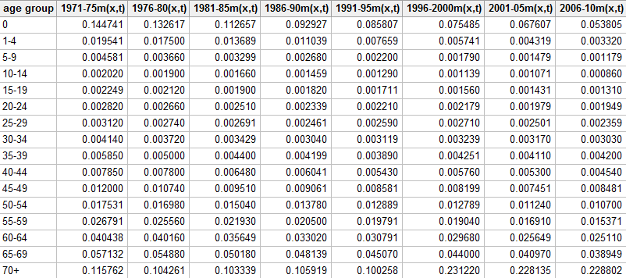
Table 1:5 year wise age group specific central death rates for Indian Male population during 1971-75 to 2006-2010

Slide 7
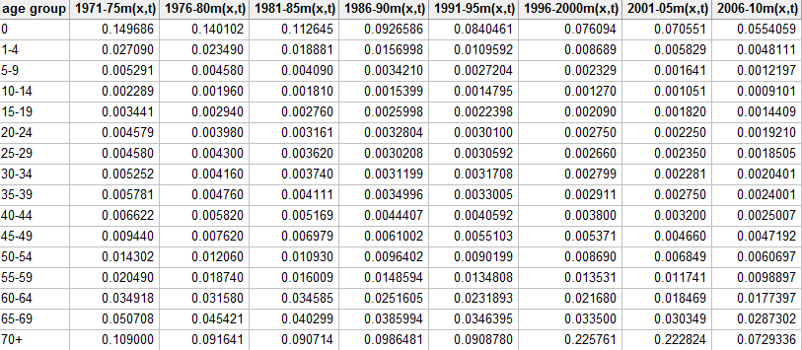
Table2:5 year wise age group specific central death rates for Indian Female population during 1971-75 to 2006-2010

Slide 8
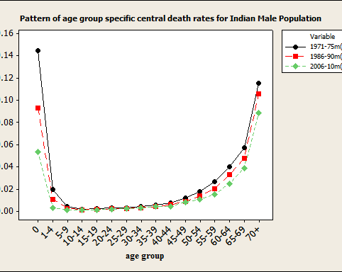
Figure 1:Pattern of age group specific central death rates for Indian Male Population To illustrate the improvement in Indian male mortality we have plotted age group specific central death rates for Indian male. Overall there has been a decline in mortality rates of India during 1971-2010.We observed higher level of decline in mortality rates during 2006-2010 compared to 1971-75.
Figure 1:Pattern of age group specific central death rates for Indian Male Population

Slide 9
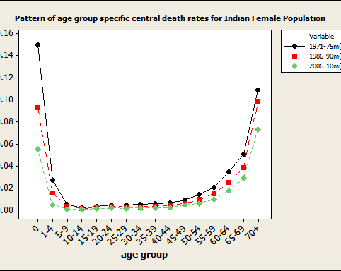
Figure 2:Pattern of age group specific central death rates for Indian Female Population
To illustrate the improvement in Indian male mortality we have plotted age group specific central death rates for Indian male. Overall there has been a decline in mortality rates of India during 1971-2010.We observed higher level of decline in mortality rates during 2006-2010 compared to 1971-75.
Figure 2:Pattern of age group specific central death rates for Indian Female Population

Slide 10
Lee-Carter Model and Parameter Estimation
Model:
Lee and Carter first established stochastic mortality model for modeling human mortality.The model is given by,
ln(m_{x,t})=a_{x}+b_{x}k_{t}+e_{x,t ………..(3)}
where,
x: age group under consideration(here in our data,x=0,1-4,5-9,……,65-69,70+)
t:period of life table under consideration(here in our data,t=1971-75,1976-80,……,2006-2010
m_{x,t}: central rate of mortality for age group x at time ‘t’
a_{x}: coefficient that describes average age specific pattern of mortality
k_{t}:denotes the time trend for the general mortality
b_{x}:coefficient which measures sensitivity of ln(m_{x,t})at age group x as the k_{t} varies
e_{x,t}:error associated with age group x and time’t’

Slide 11
Assumption:
The assumptions that Lee-Carter made for estimating the parameters of the proposed model are,
(i)∑_{x} b_{x}=1 ……….(3a)
(ii)∑_{t} k_{t}=0…………(3b)
Estimation of the parameters:
Lee-Carter suggested to apply singular value decomposition method to estimate the parameters of the model.First we estimate a_{x}̂ by using,
a_{x}̂=(1/8)∑_{t} ln(m_{x,t})……….(4)
we have obtained estimated a_{x}̂ for respective age group as,

Slide 12
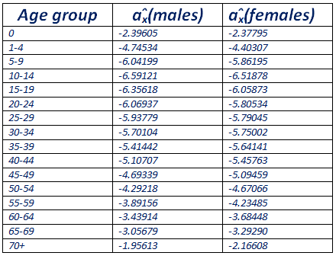

Slide 13
For obtaining estimated parameters b_{x}̂ and k_{t}̂ , we have used Singular Value decomposition Method on matrix S,where S is given by, s_{xt}= ln(m_{x,t})- a_{x}̂……….(5) Note that,S is a 16*8 matrix whose elements are obtained from equation (5)
On doing Singular Value Decomposition on S,we have got the following form S=U∑V^{T}
Where ∑ is the diagonal matrix,diagonal elements being the eigen values of the matrix SS^{T.} U and V are the corresponding Left and Right Singular vectors of S.
Lee Carter suggested that the approximation to the 1st term of the singular value decomposition osf S would give the estimated value b_{x}̂ and k_{t}̂
In other words according to Lee Carter,the 1st column of left singular matrix ie U would give the estimated value b_{x}̂ and the 1st column of right singular matrix ie V would give the estimated value k_{t}̂
The Lee Carter Model is so popular due to its simplicity for the parameter estimation by the Singular Value Decomposition method.

Slide 14
An alternative approach of estimating the parameters of the Lee-Carter model
As an alternative wayout of SVD method,Lee-Carter suggested a slightly approximated method to estimate the parameters of the model.
We can see that this model can’t be fitted by ordinary regression method,because there are no given regressors.Thus in order to obtain a least square solution of equation (3),we apply a close approximation assuming the error terms are homoscedastic.
We have,
∑_{x}ln(m_{x,t})=∑_{x} (a_{x}+b_{x}k_{t} )
Or, ∑_{x}ln(m_{x,t})=∑_{x}a_{x} + ∑_{x} b_{x}k_{t}
Or, ∑_{x} (_{x}ln(m_{x,t})-a_{x} )= k_{t}∑_{x} b_{x}
Or, k_{t} =∑_{x} (_{x}ln(m_{x,t})-a_{x} )…………(as, ∑_{x} b_{x} =1)

Slide 15
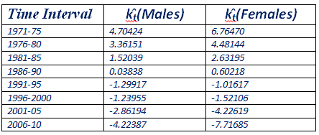
We also see that the estimated values k_{t}̂ for both males and females add up to 0,which meets one of the assumptions suggested by Lee-Carter.
An estimate of b_{x},suggested by Lee-Carter ,is obtained by regressing ∑_{x} (_{x}ln(m_{x,t})-a_{x} ) on k_{t,} which canbe obtained by minimizing the sum of squares of errors ∑_{x}(_{x}ln(m_{x,t})-a_{x}- k_{t} ) ² .The required estimate is given by,

Slide 16
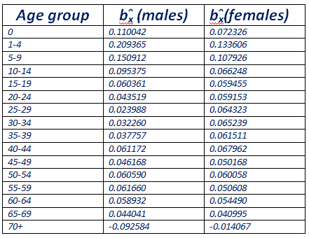
b_{x}̂ =∑_{x,t} k_{t}(_{x}ln(m_{x,t})-a_{x} )/ ∑_{t} k_{t} ²

Slide 17
We also see that the estimated values of b_{x} for both the males and the females add up to very close to 1,which meets one of the assumptions suggested by Lee-Carter.
Fitting of Lee Carter Model to Indian Mortality data:
Here,we represent the results of estimation of parameters in Lee-Carter model for the population of India based on SRS based mortality tables availbale from 1971-75 to 2006-2010.
The quantity k_{t} being time independent,is same for all age group in a certain age interval and for each ‘x’(age interval),we take the corresponding estimates of a_{x} & b_{x} to get ln(m_{x,t}).After obtaining the estimated value of ln(m_{x,t}),we can easily obtain the expected value of Age Specific Central Mortality Rate.
In the following tables we have shown the observed value and the expected value of Age Specific Central Mortality Rate for males and females respectively for some selected time intervals and plotted the graphs of observed rates and fitted rates.

Slide 18
obsd. male fitted male obsd. male fitted male
(1971-75) (1971-75) (1981-85) (1981-85)
0.144741 0.152837 0.112657 0.107664
0.019541 0.023273 0.013689 0.011950
0.004581 0.004834 0.003299 0.002990
0.002020 0.002149 0.001660 0.001587
0.002249 0.002306 0.001900 0.001903
0.002820 0.002838 0.002510 0.002471
0.003120 0.002953 0.002691 0.002736
0.004140 0.003890 0.003429 0.003511
0.005850 0.005317 0.004400 0.004715
0.007850 0.008072 0.006480 0.006644
0.012000 0.011376 0.009510 0.009821
0.017531 0.018185 0.015040 0.014995
0.026791 0.027283 0.021930 0.022420
0.040438 0.042345 0.035649 0.035101
0.057132 0.057867 0.050180 0.050296
0.115762 0.115477 0.103339 0.122838

Slide 19
obsd. male fitted male obsd. male fitted male
(1991-95) (1991-95) (2006-10 ) (2006-10)
0.085807 0.078945 0.0538047 0.057220
0.007659 0.006622 0.0033198 0.003590
0.002200 0.001954 0.0011795 0.001257
0.001290 0.001212 0.0008598 0.000917
0.001711 0.001605 0.0013100 0.001345
0.002210 0.002186 0.0019490 0.001924
0.002590 0.002557 0.0023594 0.002384
0.003119 0.003205 0.0030298 0.002917
0.003890 0.004239 0.0042003 0.003796
0.005430 0.005591 0.0045402 0.004675
0.008581 0.008623 0.0084809 0.007533
0.012889 0.012640 0.0106997 0.010587
0.019791 0.018842 0.0153708 0.015733
0.030791 0.029727 0.0251100 0.025021
0.045070 0.044423 0.0389492 0.039054
0.100258 0.109479 0.0888021 0.109075

Slide 20
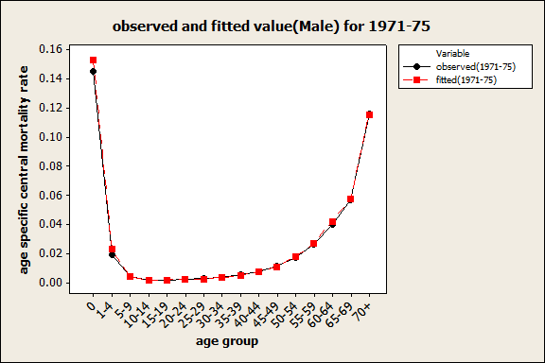
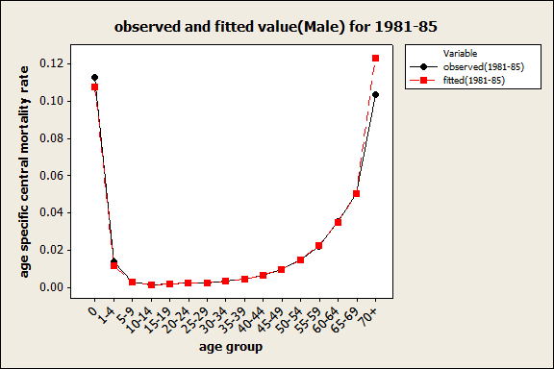
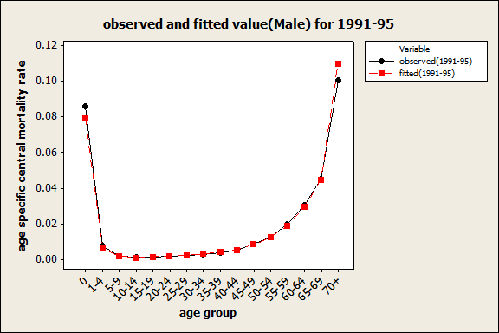
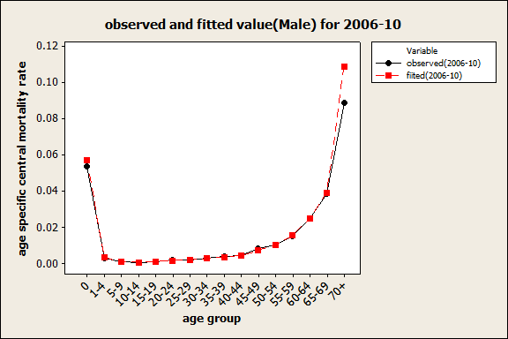

Slide 21
obsd. female fitted female obsd. female fitted female
(1971-75) (1971-75) (1981-85) (1981-85)
0.149686 0.151271 0.112645 0.112187
0.027090 0.030220 0.018881 0.017398
0.005291 0.005906 0.004090 0.003781
0.002289 0.002310 0.001810 0.001757
0.003441 0.003495 0.002760 0.002733
0.004579 0.004493 0.003161 0.003519
0.004580 0.004723 0.003620 0.003620
0.005252 0.004948 0.003740 0.003779
0.005781 0.005379 0.004111 0.004171
0.006622 0.006752 0.005169 0.005099
0.009440 0.008607 0.006979 0.006995
0.014302 0.014061 0.010930 0.010970
0.020490 0.020394 0.016009 0.016545
0.034918 0.036303 0.034585 0.028983
0.050708 0.049017 0.040299 0.041378
0.109000 0.104221 0.090714 0.110460

Slide 22
obsd. female fitted female obsd. female fitted female
(1991-95) (1991-95) (2006-10) (2006-10)
0.0840461 0.086169 0.0554059 0.053073
0.0109592 0.010686 0.0048111 0.004365
0.0027204 0.002550 0.0012197 0.001237
0.0014795 0.001379 0.0009101 0.000885
0.0022398 0.002200 0.0014409 0.001477
0.0030100 0.002836 0.0019210 0.001908
0.0030592 0.002863 0.0018505 0.001861
0.0031708 0.002979 0.0020401 0.001924
0.0033005 0.003333 0.0024001 0.002207
0.0040592 0.003979 0.0025007 0.002524
0.0055103 0.005825 0.0047192 0.004162
0.0090199 0.008812 0.0060697 0.005892
0.0134808 0.013756 0.0098897 0.009800
0.0231893 0.023758 0.0177397 0.016491
0.0346395 0.035630 0.0287302 0.027072
0.0908780 0.116277 0.0729336 0.127770

Slide 23
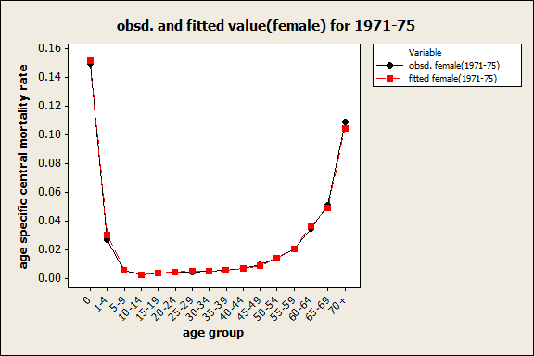
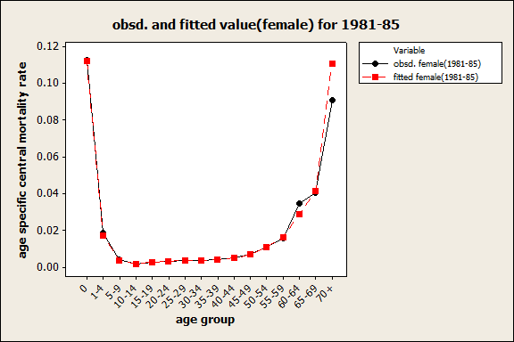
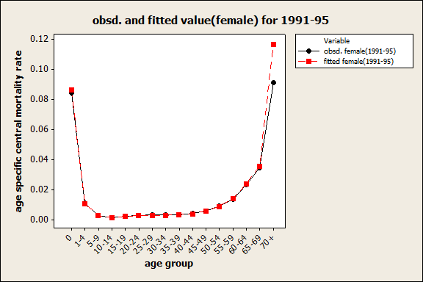
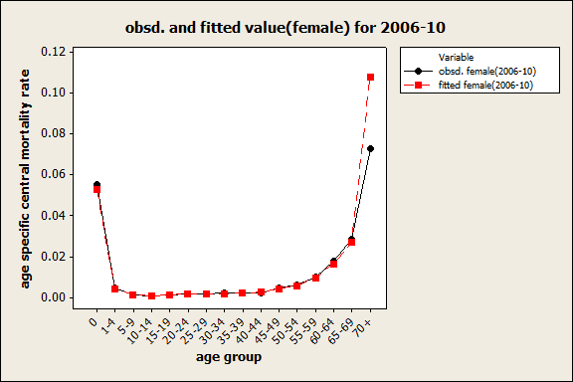

Slide 24
The obtained results from the table and the graphs above indicate that the fitted mortality rates for males obtained by fitting the Lee-Carter model are generally very close to the observed(actual) mortality rates which shows that the fit is very good.
Application of Lee-Carter Model:
Forecasting is the main aim behind the stochastic modelling of Lee-Carter model.One of the notable significance of this model is,once it is fitted (ie, once the values of a_{x} , b_{x} & k_{t} are found),only the mortality index (k_{t} ) over time needs to be obtained for fiture time intervals.
Lee-Carter applied Auto Regressive Integrated Moving average (ARIMA) process and proposed its order (0,1,0) (ie,random walk with drift) for modeling mortality index k_{t .}

Slide 25
Application in Health sector:
The forecasted central mortality rates is used to present a clear picture of gender wise age specific mortality prevailing in the country which can be used to form plans to reduce the mortality if it is high spcially in case of Infant Mortality Rates.
Actuarial Application:
Forecasted values of Age Specific Central Mortality Rates in terms of number of deaths per 1,00,000 people are used in the evaluation of actuarial quantities.
From the forecasted values of the Central Mortality Rates,life expectencies are employed by the insurance companies for determining rates of premium,Net Single Premium(NSP-present value of the future death benefit) for policies of persons at different age groups while government or a private firm may use it for determining rates of retirement benefits for its employees.

Slide 26
Conclusion:
We have modeled the age group specific central mortality rates of Indian male and female population by using the Lee-Carter model based on 5 year based mortality data from 1971-75 to 2006-10.
We have observed the following,-----
(i)The general pattern of mortality respectively for both males and females show high infant mortality.Prematurity and low birth weight are the reasons behind this.The first 4 weeks of births have been considered to have a very high risk of infant death and death during this period is called Neonatal Mortality Rate.
(ii)Mortality trend has shown decreasing trend from year to year.
(iii)Mortality improvement have been observed specially in case of infants.

Slide 27
References:
(i)https://www.google.com/url?sa=t&source=web&rct=j&url=https://sljastats.sljol.info/articles/10.4038/sljastats.v17i1.7845/galley/5936/download/&ved=2ahUKEwjKz8aSu67oAhXF6XMBHbweDrkQFjABegQIChAH&usg=AOvVaw3wOY6gj3z2M5a-mXJVWxOd
(ii)https://www.google.com/url?sa=t&source=web&rct=j&url=https://arxiv.org/pdf/1811.09622&ved=2ahUKEwiTycXpua7oAhXOyTgGHZfUC-MQFjABegQICxAH&usg=AOvVaw2fzxqxAEoGQ8tkHCGe_u_v
(iii)https://www.google.com/url?sa=t&source=web&rct=j&url=https://en.m.wikipedia.org/wiki/Lee%25E2%2580%2593Carter_model&ved=2ahUKEwiE3ezzuq7oAhX-83MBHV17CrMQFjAOegQIDRAf&usg=AOvVaw2PxlBXVkXktd7IDxX3I4Rk
(iv)https://www.google.com/url?sa=t&source=web&rct=j&url=https://www.cass.city.ac.uk/__data/assets/pdf_file/0005/37157/167ARP.pdf&ved=2ahUKEwjhxZrRu67oAhWHSH0KHYbWBDsQFjACegQIAhAB&usg=AOvVaw2rcWiN4n2kfXG0SHm5a7Vl&cshid=1584893311256
(v)Technical Demography-R Ramakumar

